Slide 1
Please complete the University Course Eval! https://tamu.aefis.net
Should take only 2-10 minutes, depending on whether you are willing to leave comments, too. I hope you will, and the more specific, the better.
My Promise: If you leave comments, I WILL READ them. Previous student comments have led me to change my course design in big and small ways.

Slide 2
Tough Issues & State Policy
Chapter 12B, Part 2
Tough Issue #2: Healthcare (Part 2)
Dr. Dwight Roblyer

Slide 3
Learning Objectives:
Describe the inherent problems associated with delaying or avoiding necessary healthcare, as well as those connected to seeking indigent care in hospital emergency rooms.
Explain who the ACA is designed to help, how it does so, and why it is not free for the participants.
Explain who Medicaid is designed to help, how it does so, and how the federal-state partnership works.
Map out the Texas Medicaid caseload and costs based on the 3 major groups of recipients. Describe patterns that are present.
Describe how individuals, based on their income, obtained healthcare before and after ACA.
Describe the players that helped craft the ACA and their motivations.
List the changes to healthcare insurance that ACA caused, even though many Americans don’t realize that the ACA was the reason.
Explain the state mandate in the ACA, the Supreme Court decision regarding it, and the situation that was created.
Characterize the various positions of the states on the ACA-sanctioned expansion of Medicaid. Do the same for the variations in percentages of uninsured residents in each state and note any patterns with each state’s position on expansion.

Slide 4
Learning Objectives:
Describe the nature of the shift in states’ positions on expansion between 2013 and 2018.
Describe the positions of the Texas populace and the Texas Legislature regarding Medicaid expansion here.
Explain the profile that Texas uses to determine who is eligible for Medicaid in the state, as well as how it would change if Texas decided to expand Medicaid access under the ACA. Discuss how this highlights the conservative values that Texas references for not expanding.
Discuss the gap in provision of healthcare in states like Texas that have not expanded Medicaid. Characterize which states and regions have residents that fall into this gap.
Describe the various reasons that Texas politicians have given for not expanding Medicaid in the state. Explain possible counterpoints for each.
Describe the healthcare situation for Texans in 2014 and compare it to other states.
Define the individual mandate within the ACA and explain why it was necessary given the private-insurance-based approach used in the law.
Explain how the loss of insurers from the ACA marketplace was a normal occurrence within insurance markets.

Slide 5
What’s the issue? What if you can’t pay?
A large number of Americans are uninsured and cannot afford medical care, so they delay it, skip it, or go to a nearby Emergency Room and then do not pay their bill
People who push out or avoid care have significantly worse health, productivity, quality of life, and life expectancy
Those who obtain “indigent” care from hospital emergency rooms each leave thousands of dollars in unpaid bills that others must eventually pay

Slide 6
What’s the issue? What if you can’t pay?
A large number of Americans are uninsured and cannot afford medical care, so they delay it, skip it, or go to a nearby Emergency Room and then do not pay their bill
People who push out or avoid care have significantly worse health, productivity, quality of life, and life expectancy
Those who obtain “indigent” care from hospital emergency rooms each leave thousands of dollars in unpaid bills that others must eventually pay
Depending on your perspective, these “uninsureds” result in one or more problems
Humanitarian – They suffer individually, sometimes greatly
Societal – Their poor health hurts their families and communities
Economic – They are burdens on commercial productivity and drain away tax and charity dollars from other needs

Slide 7
What’s so tough about this issue? Government Can Only Help Some
How does someone who is uninsured obtain long-term help with their medical bills?
Under the Affordable Care Act, people with income at or above 133% of the Federal Poverty Level (FPL) can obtain health insurance for reduced premiums that are keyed to their annual income (e.g., about $200/mo for a person making $24,000 per year)
The federal government heavily subsidizes the actual premium amount to make it affordable for individuals
These individuals will still need to pay $1000s more each year in premiums, deductibles, co-pays, etc.
WARNING: Available plans can be confusing and may be accepted by very few doctors

Slide 8
What’s so tough about this issue? Government Can Only Help Some
For those too young/old/sick to work, or otherwise with income below the FPL, there is the federal Medicaid program
Pays for all necessary medical care
Not same as Medicare (for seniors)
Joint federal-state program, but feds pay most of costs via grants
However, the states tailor their programs to determine who is eligible and who is not – Texas has some of tightest restrictions

Slide 9
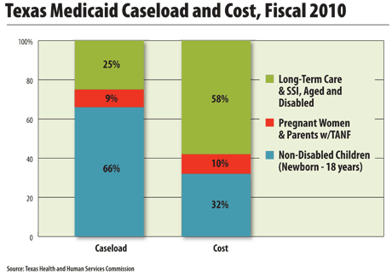
Which group of Texas residents are missing?
Remember % of children in poverty from Chpt 12A?
Surprised? Which group is giving the state the “best deal?”
Who is the most expensive?

Slide 10
Before ACA…
Federal Poverty Line
Self-Pay or Employer-Provided Insurance
No Income
Medicaid
High Income
The ACA way…
Federal Poverty Line
Self-Pay or Employer-Provided Insurance
No Income
Expanded Medicaid
ACA-Subsidized
High Income
133% of Federal Poverty Line

Slide 11
The Affordable Care Act (ACA)
Formally: The Patient Protection and Affordable Care Act
Colloquially: “Obamacare”
Passed by Congress, signed by the President
Hard-fought battle between many major interest group & political party players
Hospitals, doctors, pharmaceutical companies, insurance companies, etc.
All wanted to ensure they were “winners” in at least some aspects
Remember about the role of interest groups in Chpt 7?

Slide 12
The Affordable Care Act (ACA)
Wide-reaching, multifaceted federal law to address very serious problems in the American healthcare system
Created a non-ideal mechanism for low-income Americans to obtain affordable health insurance
Authorized expansion of Medicaid to cover more needy individuals
Plus important reforms that most people don’t credit to ACA:
Created minimum standards for what bills would be covered by a policy
Made it illegal for insurers to deny insurance coverage to anyone due to their health conditions
Allowed adult children to remain on their parents’ policy for much longer period of time

Slide 13
ACA and the States (or, “How policy can get a lot messier… fast!”)
Affordable Care Act originally required all states to expand Medicaid coverage to more residents starting in 2014
To provide Medicaid services for all citizens at or below 133% of federal poverty level
ACA also required each state to establish an “insurance exchange” so residents could obtain private insurance subsidized by the federal government
In 2013, US Supreme Court upheld ACA law in general, but struck down “state mandate”
Federal government cannot force additional Medicaid coverage upon states, nor can it force each state to establish an insurance exchange

Slide 14
Before ACA…
Federal Poverty Line
Self-Pay or Employer-Provided Insurance
No Income
Medicaid
High Income
The ACA way…
Federal Poverty Line
Self-Pay or Employer-Provided Insurance
No Income
Expanded Medicaid
ACA-Subsidized
High Income
133% of Federal Poverty Line

Slide 15
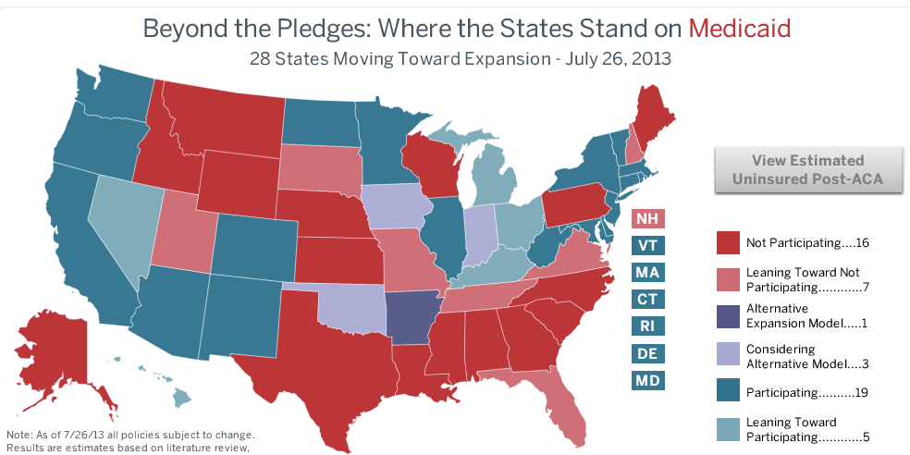
…So do the states that are turning down the expansion have large percentage of already-insured residents? (…next slide)
http://www.advisory.com/Daily-Briefing/Resources/Primers/MedicaidMap#lightbox/2/

Slide 16
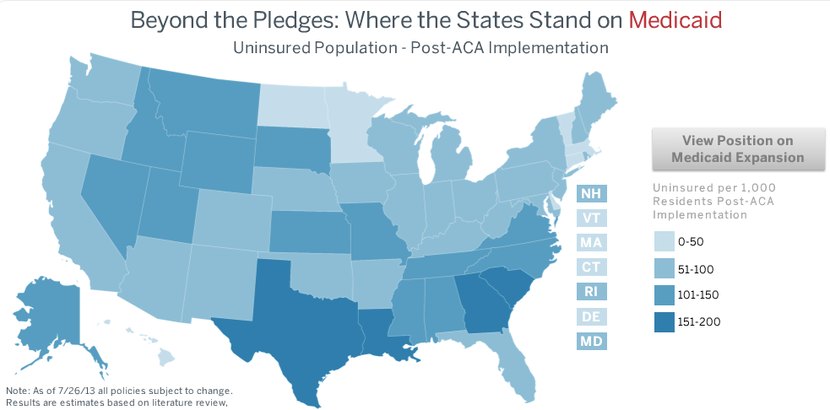
…No. Actually most of the states that are turning down the expansion have the largest percentages of non-insured residents
http://www.advisory.com/Daily-Briefing/Resources/Primers/MedicaidMap#lightbox/2/

Slide 17
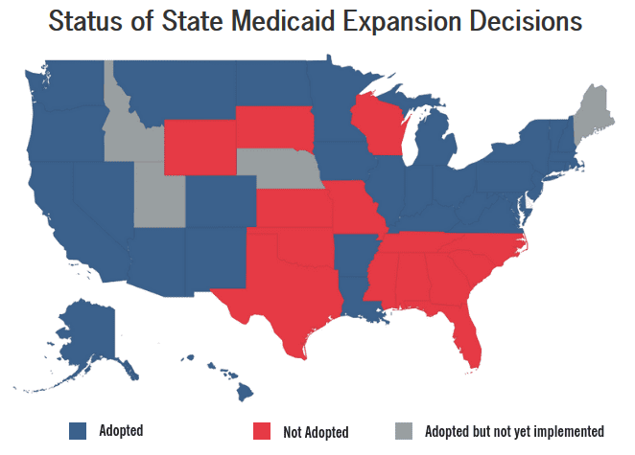
Post 2018 Election
https://bipartisanpolicy.org/blog/medicaid-expansion-wins-big-in-midterm-elections/

Slide 18
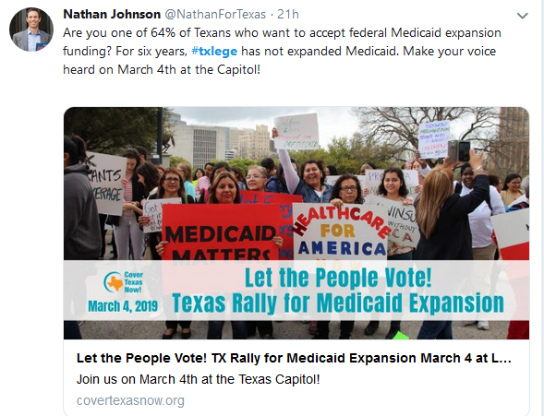
Should Texas Expand Medicaid?
https://twitter.com/hashtag/txlege?src=hash&ref_src=twsrc%5Etfw

Slide 19
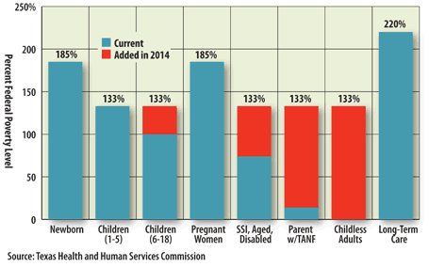
Impact of Texas participation in Medicaid Expansion IF it had happened…
These are qualification levels for Medicaid services in Texas
Biggest benefit, biggest cost
Notes:
http://www.thetexaseconomy.org/healthcare/federal-leg/articles/article.php?name=medicaid_primer
Due to federal health care reform, in 2014 all states will be required to provide Medicaid services for all citizens at or below 133 percent of FPL with Medicaid services. At present, Texas Medicaid does not cover childless adults, and has stiffer income requirements than 133 percent of FPL for some services.
US SUPREME COURT UPHELD AFFORDABLE CARE ACT BUT STRUCK THIS PART. FEDERAL GOVERNMENT CANNOT FORCE ADDITIONAL MEDICAID COVERAGE

Slide 20
“Mind the Gap” – Another way that policy gets messy…
Congress wrote ACA so that those at or below 133% of the Federal Poverty Level could not obtain subsidized insurance
Instead, these Americans would be covered by expanded Medicaid
When some states refused to expand Medicaid, this left millions of people without medical coverage
Income was too high to qualify for Medicaid
Income was too low to qualify for ACA subsidies
Federal Poverty Line
Self-Pay or Employer-Provided Insurance
No Income
Medicaid
ACA-Subsidized
High Income
133% of Federal Poverty Line

Slide 21
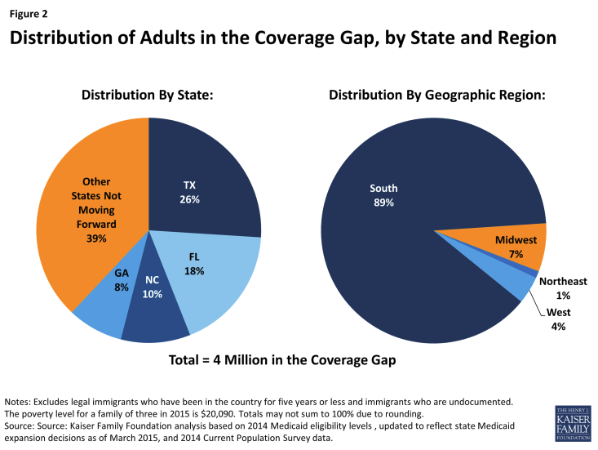
“Mind the Gap”
How many people are affected and where do they live?
http://kff.org/health-reform/issue-brief/the-coverage-gap-uninsured-poor-adults-in-states-that-do-not-expand-medicaid-an-update/

Slide 22
Why did Texas Not Expand?
Didn’t want additional federal intervention in state
BUT one-third of state budget is already coming from feds
Planned to devise “Texas Plan” to reform healthcare
BUT would feds agree to return Medicaid-funding tax $$ to Texas?
BUT would Texas be able to craft more efficient system?
BUT would Texas be willing to use “new money” to extend benefits to new beneficiaries, or find other “pressing” needs?
Couldn’t afford additional costs
BUT most all of costs was to have been funded by feds
BUT studies had shown large numbers of new jobs would accompany the enlargement of healthcare system
Didn’t trust federal government wouldn’t continue to pay promised bills
BUT already trusting feds to pay for roads, school lunches, etc.
Remember Chpt 5?

Slide 23
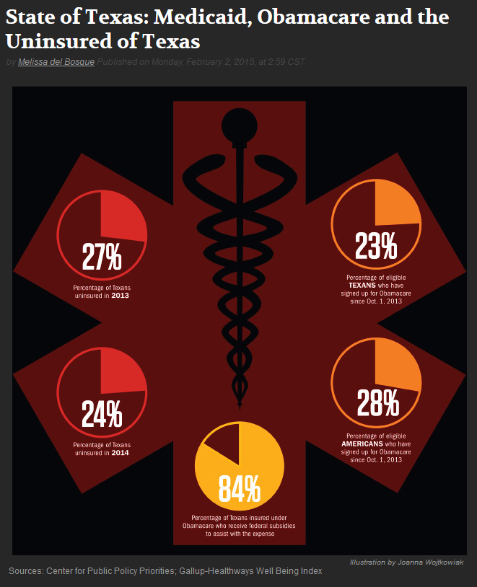
Where Texas stood in 2014 (by the numbers)
In 2014, 24% of Texans were uninsured*
This was a 3% improvement from 2013
In 2014, 23% of low-income Texans had obtained insurance under the ACA
This rate is 5% less than for all low-income Americans
Of all ACA-insured Texans, 84% of them are receiving a federal subsidy toward their monthly premiums
Texas still led the nation in uninsured residents
* “uninsured” excludes individuals
with Medicaid
http://www.texasobserver.org/state-texas-medicaid-obamacare-uninsured-texas/

Slide 24
…and what about that Individual Mandate?
Why do people have to pay a penalty if they don’t have insurance?
Because…
…ACA was an insurance-based policy—not a “socialized medicine single-payer” model
…insurance only works when the insured pool includes lots of healthy people who pay premiums (paying in more than they withdraw in benefits!)
…in order to create a pool big enough to make this insurance-based solution work, Americans had to be “encouraged” to join through penalties if they didn’t!
No penalties, no sufficiently large pool, no solution!

Slide 25
…so why were so many insurers quitting ACA?
A lot of reasons are behind these decisions
Two big ones:
Insurance companies competed with each other to sell subsidized policies via ACA—some companies priced their policies too low, and couldn’t make enough profit
ACA policy buyers were sicker than even the government anticipated, so had more claims
Private market-based solution? Private market risks!

Slide 26
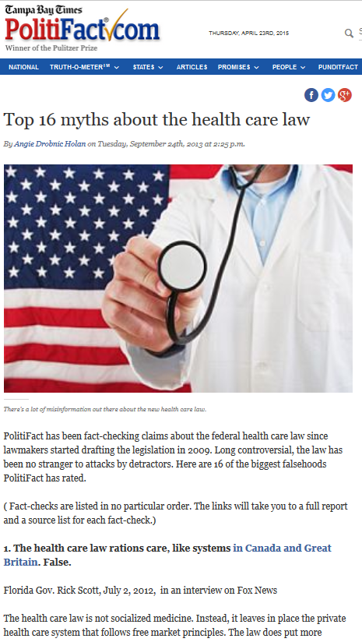

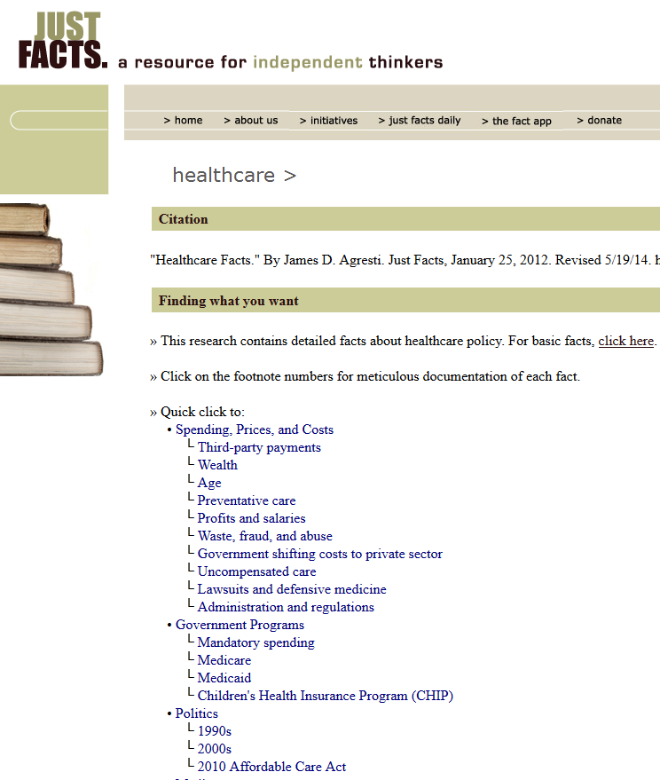
Want to Learn More About Healthcare, Texas, and the ACA?
Topic of extra credit assignment: “Demography and Healthcare”
Panel discussion between a Texas state legislator, county treasurer, former state demographer, healthcare philanthropist, and an academic
Don’t just listen to the politicians! Distortions are the rule on both sides…
Do some fact checking of your own
https://www.justfacts.com/healthcare.asp
http://www.politifact.com/truth-o-meter/article/2013/sep/24/top-16-myths-about-health-care-law/
http://www.factcheck.org/issue/affordable-care-act/

Slide 27
Practice Problems …to begin mastering this material. Complete instructions are in the Module 1 resource, How to Use Practice Problems to Prepare for Exams.
Don’t forget to do the…

Slide 28
Please complete the University Course Eval! https://tamu.aefis.net
Should take only 2-10 minutes, depending on whether you are willing to leave comments, too. I hope you will, and the more specific, the better.
My Promise: If you leave comments, I WILL READ them. Previous student comments have led me to change my course design in big and small ways.

